Slide 1
Introduction to CloudLab
Linh B. Ngo
Clemson CITI

Slide 2
Hands-on Preparation
Create a GitHub account at www.github.com
Setup shell access
Windows
MobaXTerm: https://mobaxterm.mobatek.net/download-home-edition.html
Use Installer Edition
Mac and Linux
Default terminal

Slide 3
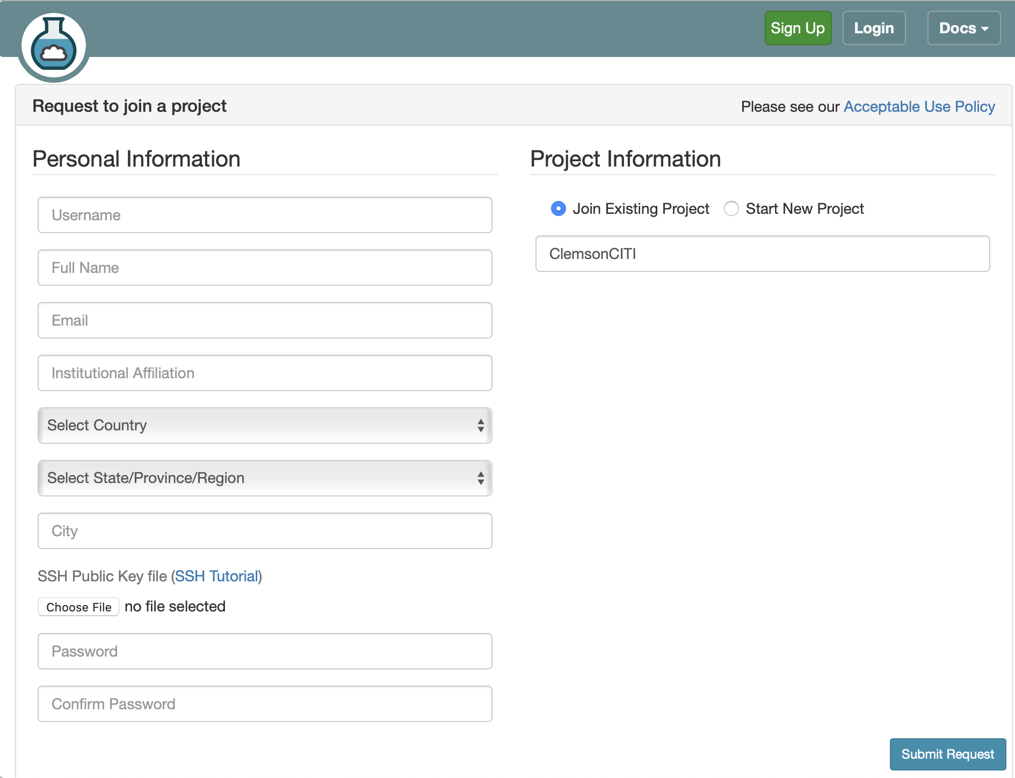
Joining CloudLab without prior account
Go to www.cloudlab.us
Username: xxxxxxxx
Email: Your_Clemson_Email
Institutional Affiliation: Clemson University
Ignore SSH Public Key file for now.
Provide and confirm a secure password
Join Existing Project: ClemsonCITI

Slide 4
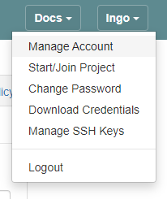
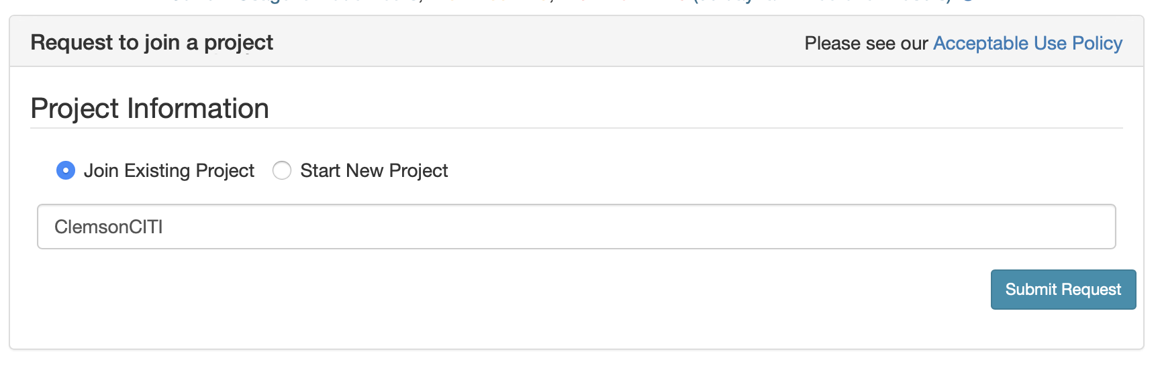
Join ClemsonCITI project with existing CloudLab/GENILab account
Login to your existing CloudLab account.
Upper right corner: Start/Join Project
Join Existing Project: ClemsonCITI

Slide 5
What is CloudLab?
Experimental testbed for future computing research
Allow researchers control to the bare metal
Diverse, distributed resources at large scale
Allow repeatable and scientific design of experiments

Slide 6
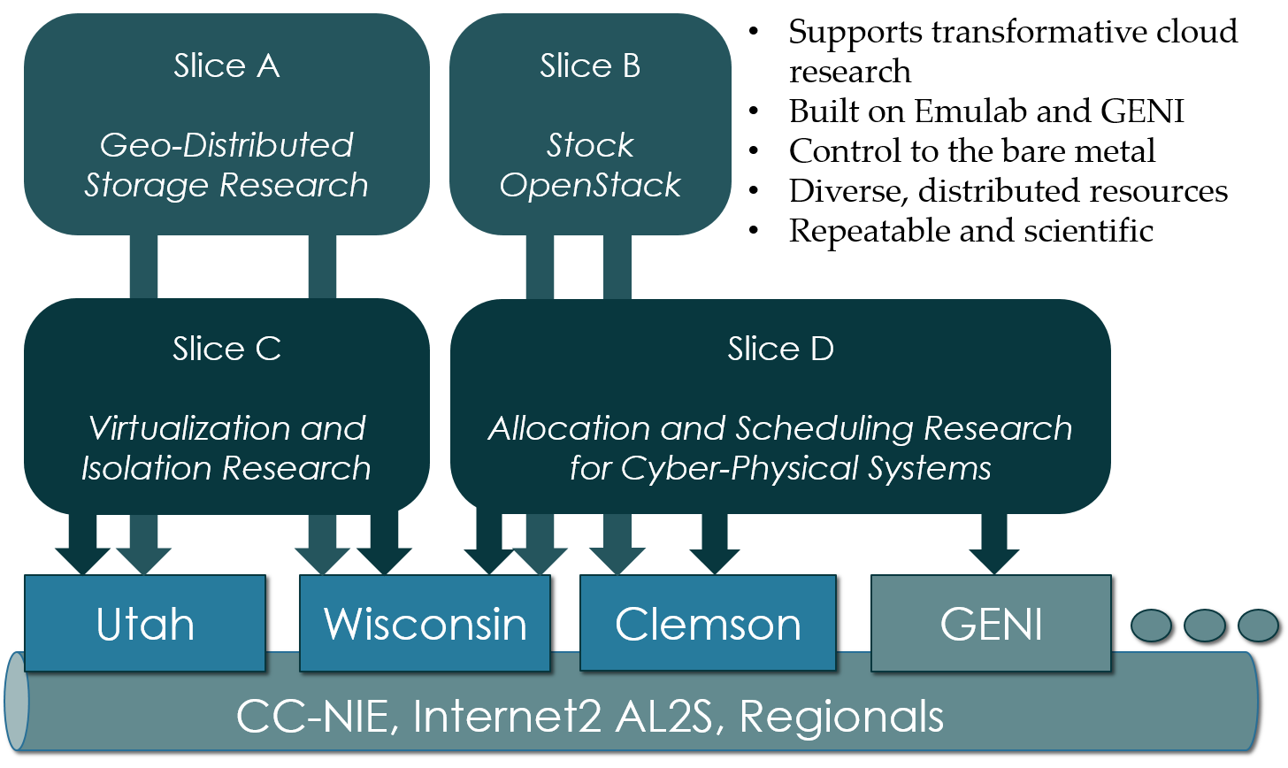

Slide 7
What is GENI?
Global Environment for Networking Innovation
"Combining heterogeneous resource types, each virtualized along one or more suitable dimensions, to produce a single platform for network science researchers"
Key components:
GENI racks: virtualized computation and storage resources
Software-defined networks (SDNs): virtualized, programmable network resources
WiMAX: virtualized cellular wireless communication
Berman, M., Chase, J.S., Landweber, L., Nakao, A., Ott, M., Raychaudhuri, D., Ricci, R. and Seskar, I., 2014. GENI: A federated testbed for innovative network experiments. Computer Networks, 61, pp.5-23.

Slide 8
Key experimental concepts
Scliceability: the ability to support virtualization while maintaining some degree of isolation for simultaneous experiments
Deep programmability: the ability to influence the behavior of computing, storage, routing, and forwarding components deep inside the network, not just at or near the network edge.

Slide 9
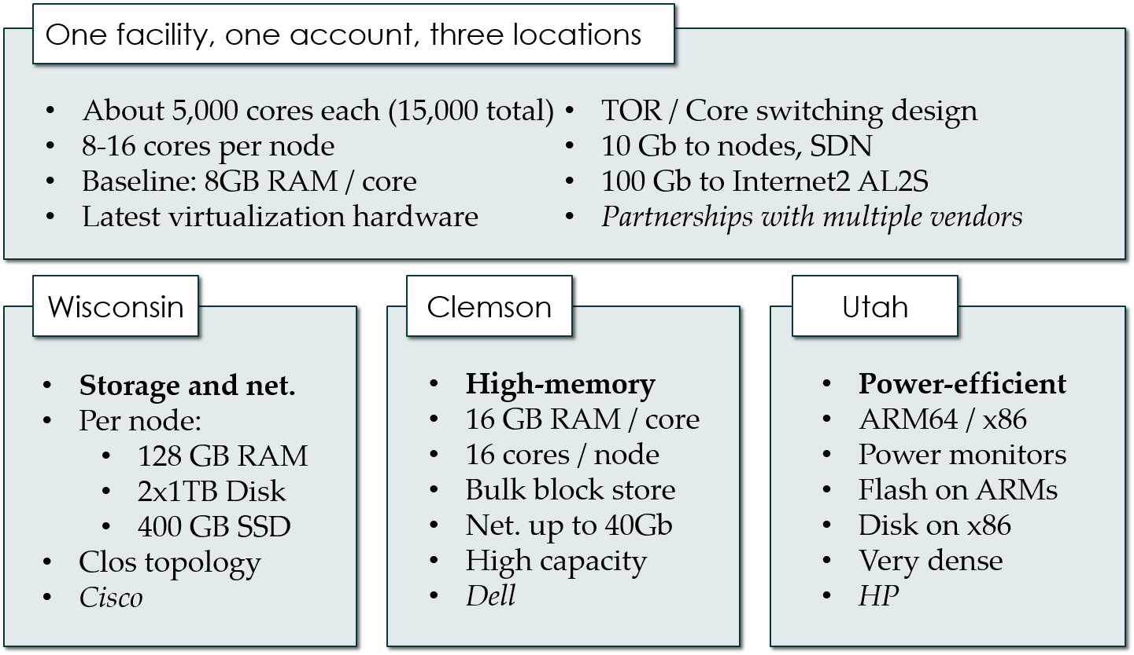

Slide 10
Utah/HP: Low-power ARM64 (785 nodes)
315 m400: 1X 8-core ARMv8 at 2.4GHz, 64GB RAM, 120GB flash
270 m510: 1X 8-core Intel Xeon D-1548 at 2.0 GHz, 64GB RAM, 256 GB flash
200 xl170: 1X 10-core Intel E5-2640v4 at 2.4 Ghz, 64 GB RAM, 480 GB SSD

Slide 11
Suitable for experiments that
explore power/performance tradeoff
want instrumentation of power and temperature
want large numbers of nodes and cores
need bare-metal control over switches
want tight ARM64 platform integration

Slide 12
Wisconsin/Cisco (530 nodes)
90 c220g1: 2X 8-core Intel Haswell at 2.4GHz, 128GB RAM, 1X 480GB SDD, 2X 1.2TB HDD
10 c240g1: 2X 8-core Intel Haswell at 2.4GHz, 128GB RAM, 1X 480GB SDD, 1X 1TB HDD, 12X 3TB HDD
163 c220g2: 2X 10-core Intel Haswell at 2.6GHz, 160GB RAM, 1X 480GB SDD, 2X 1.2TB HDD
7 c240g2: 2X Intel Haswell 10-core at 2.6GHz, 160GB RAM, 2X 480GB SDD, 12X 3TB HDD
224 c220g5: 2X 10-core Intel Skylake at 2.20GHz, 192GB RAM, 1TB HDD
32 c240g5: 2X 10-core Intel Skylake at 2.20GHz, 192GB RAM, 1TB HDD, 1 NVIDIA P100 GPU
4 c4130: 2X 8-core Intel Broadwell at 3.20GHz, 128GB RAM, 2X 960GB HDD, 4 NVIDIA V100 GPU

Slide 13
Suitable for experiments that
want large number of nodes/cores, and bare metal control over nodes/switches
want network I/O performance, intra-cloud routing, and transport
network virtualization
in-memory big data frameworks
cloud-scale resource management and scheduling

Slide 14
Clemson/Dell (256 nodes)
96 c8220: 2X 10-core Intel Ivy Bridge at 2.2GHz, 256GB RAM, 2X 1TB HDD
4 c8220x: 2X 10-core Intel Ivy Bridge at 2.2GHz, 256GB RAM, 8X 1TB HDD, 12X 4TB HDD
84 c6420: 2X 14-core Intel Haswell at 2.0GHz, 256GB RAM, 2X 1TB HDD
2 c4130: 2X 12-core Intel Haswell at 2.5GHz, 256GB RAM, 2X 1TB HDD, 2 NVIDIA K40m GPU
2 dss7500: 2X 6-core Intel Haswell at 2.4GHZ, 128GN RAM, 2X 126GB SSD, 45X 6TB HDD
72 c6420: 2X 16-core Intel Skylake at 2.6GHZ, 386GB RAM, 2X 1TB HDD

Slide 15
Suitable for experiments that
need large per-core memory
want to experiment with IB and/or GbE networks
need bare-metal control over switches

Slide 16
CloudLab
Setup SSH Key
Creating your first CloudLab profile using the GUI
Instantiating your first experiment

Slide 17
Setup SSH key and passwordless SSH
Open up your terminal.
Run the following command:
$ cat ~/.ssh/id_rsa.pub
If you do not have id_rsa.pub, run:
$ ssh-keygen -t rsa
Hit Enter for ALL questions (including the one about password)

Slide 18
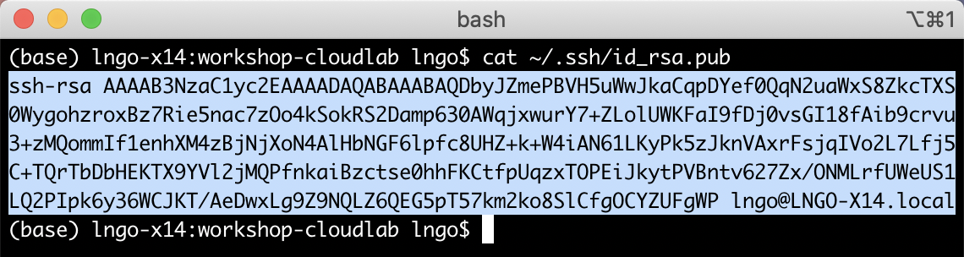
id_rsa.pub
The below screenshot is an example of public keys from Mac
Paint and copy the entire key.

Slide 19
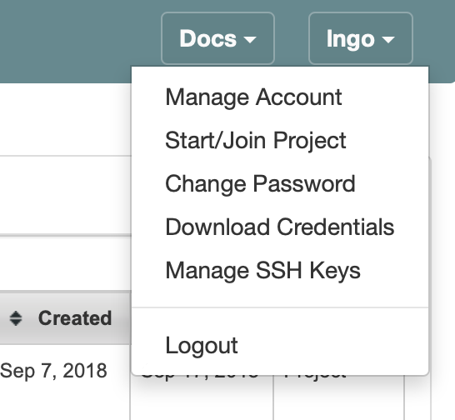
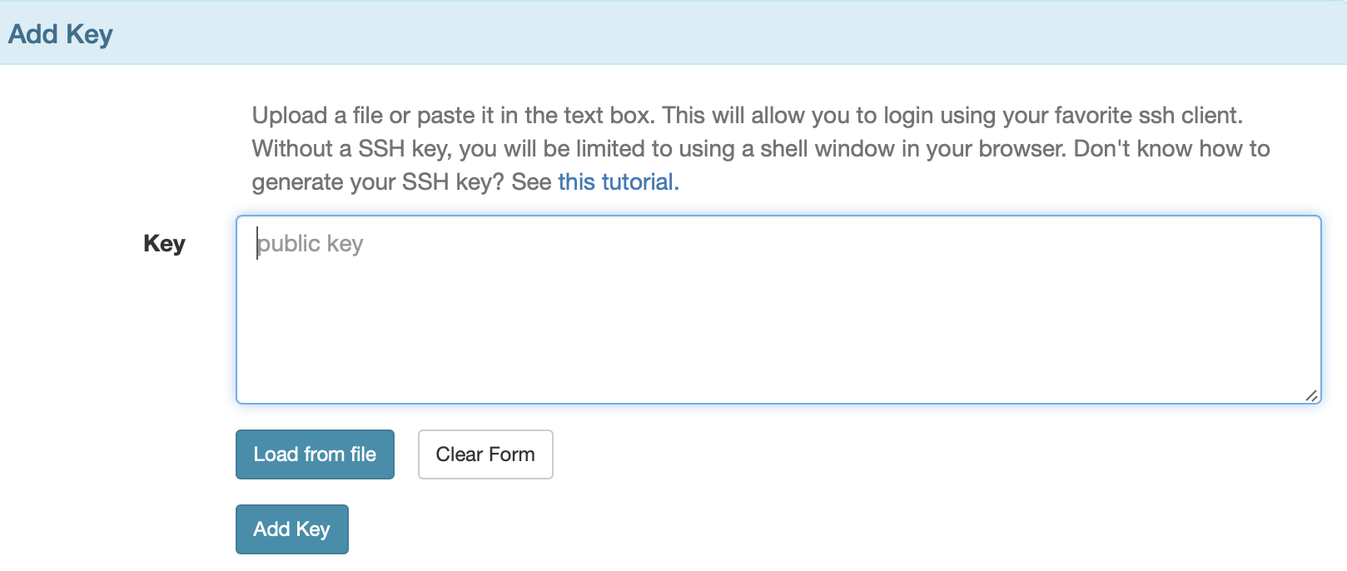
Log into Cloud
On the upper right corner, click on your username then Manage SSH Keys
Paste the copy key into the box and click Add Key
If you know where the id_rsa.pub file is, you can also use the Load from file option

Slide 20
Notes
CloudLab secure access to experiments (security OF the cloud) by disabling passworded access by default.
You can only SSH into your experiment from a local terminal if you have added the SSH key or if you enable direct password access (DO NOT DO THIS, THIS IS BAD HABIT).
You can add as many keys as you want (for access from different locations).
Without a key, you can still access your experiment via an in-browser terminal (slow and inconvenient).

Slide 21
Terminology
Profile: describing how you want to setup your experiment. The description includes selections regarding hardware (physical or virtual, X86-64 or ARM), operating systems (distro, versions, …), and how the software stack inside individual components (compute nodes) of the experiments should be installed and configured. A profile can be created via a GUI interface (limited) or via a Python program (extremely expressive).
Experiment: A deployment instance of a profile in CloudLab infrastructure. A profile can have multiple experiments instantiated simultaneously.
Analogy: similar to object-oriented programming, a profile is equivalent to a class, while an experiment is an object instance of that class.

Slide 22
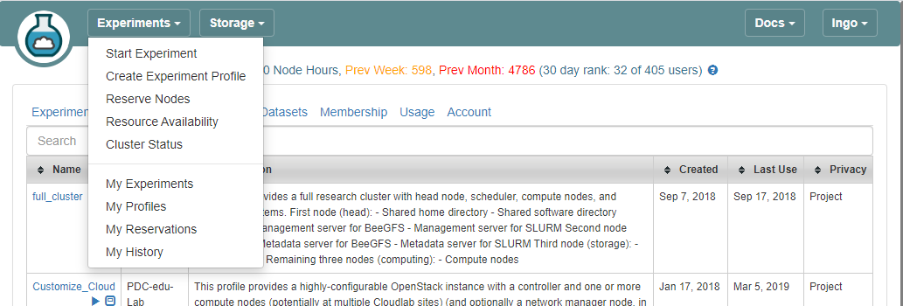
Log into CloudLab

Slide 23
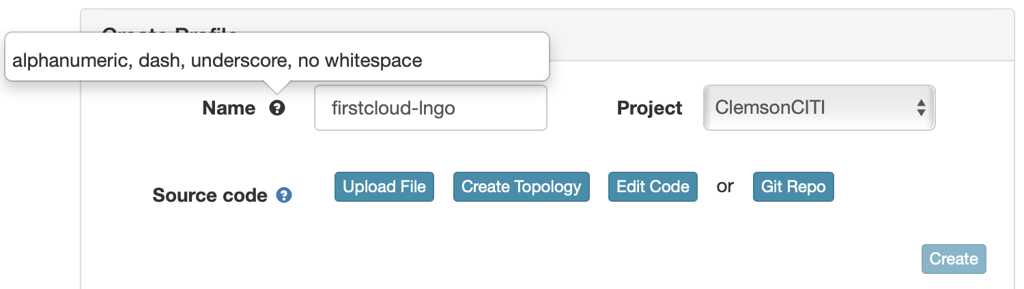
Use the Topology GUI
Mouse over question marks for more information.
If you are part of multiple projects, the Project box is in drop-down mode.

Slide 24
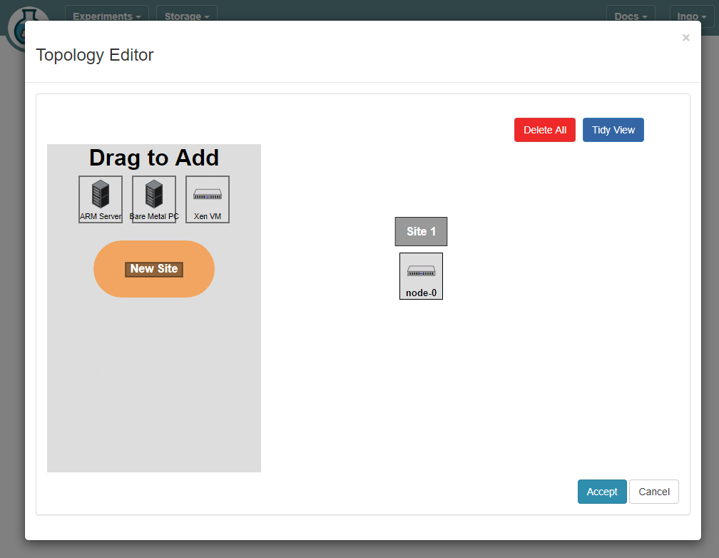
Drag a XenVM square to the right.

Slide 25
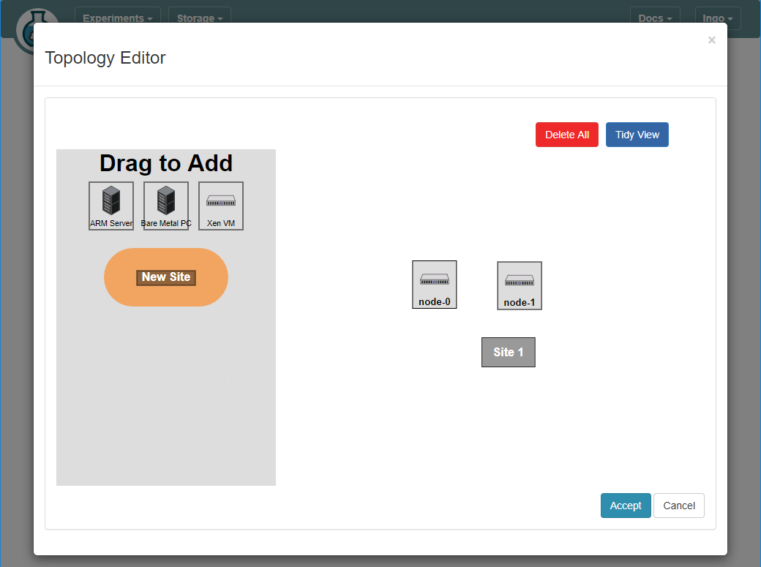
Drag another XenVM square to the right.

Slide 26
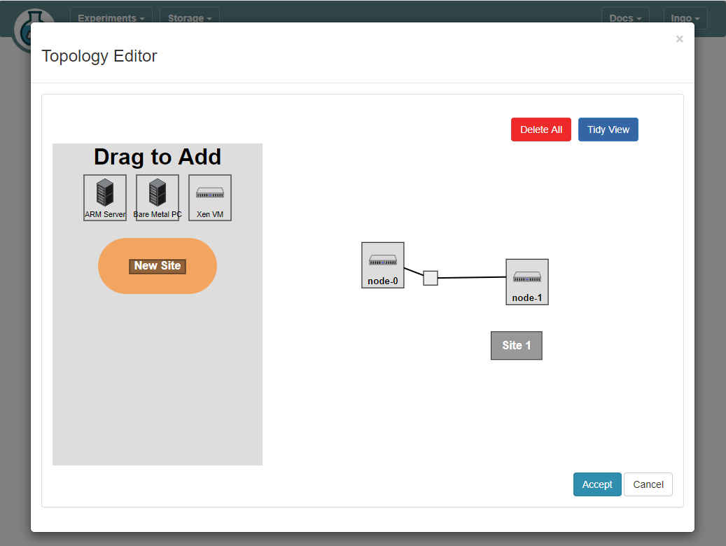
Hold and drag a line from one node to another

Slide 27
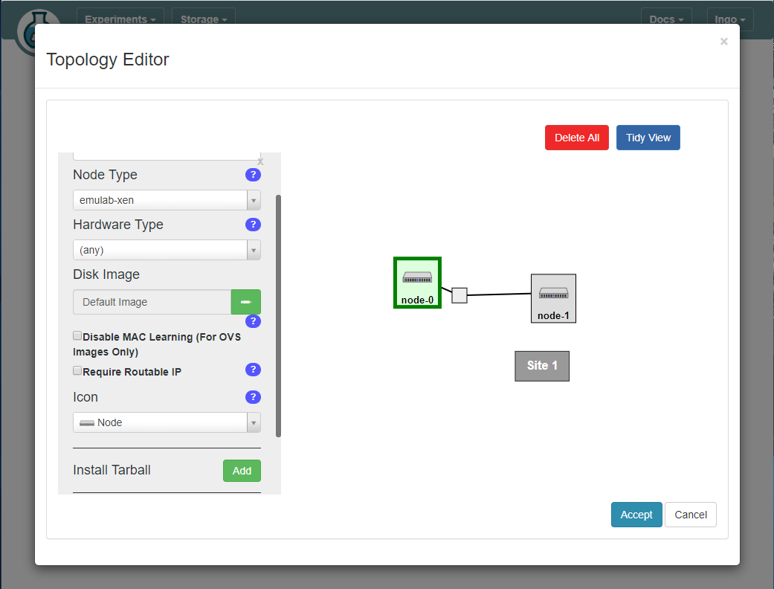
Click on node-0 and check “Require Routable IP” then Accept

Slide 28
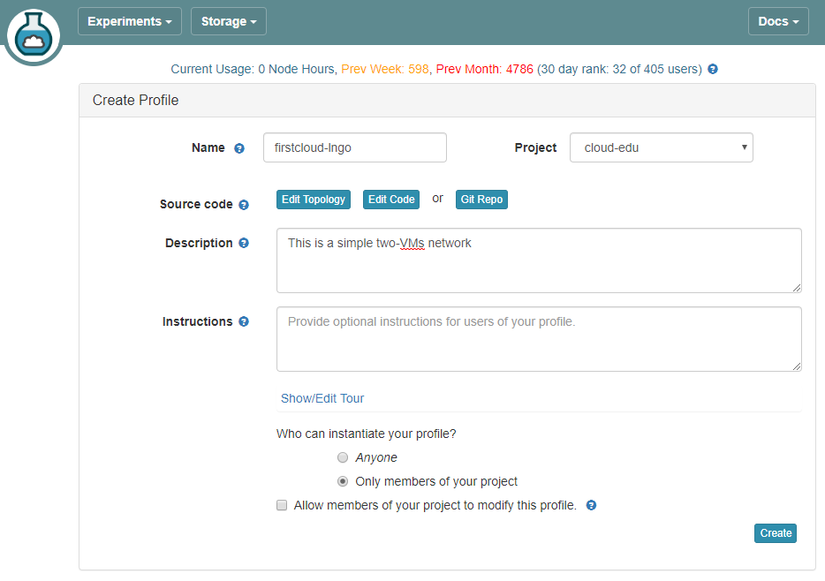
Fill out the Description and then Create

Slide 29
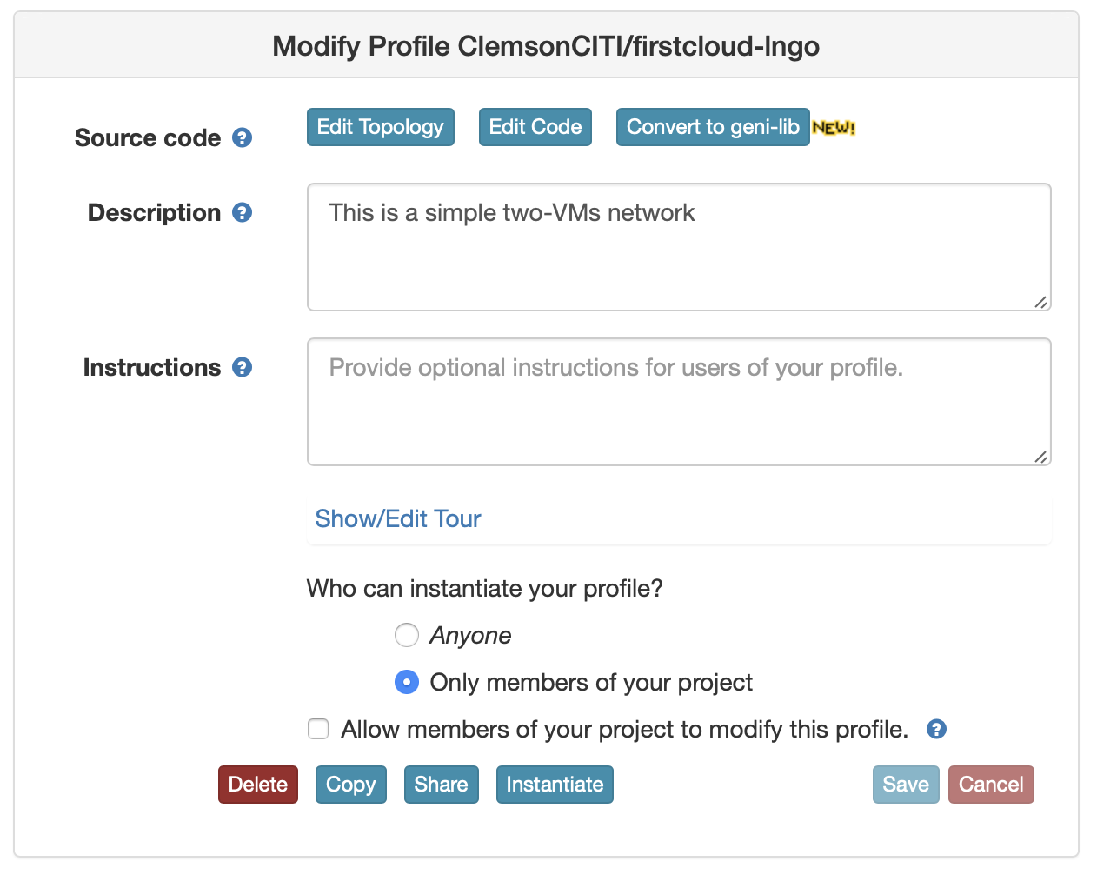
Instantiate an experiment from the profile

Slide 30
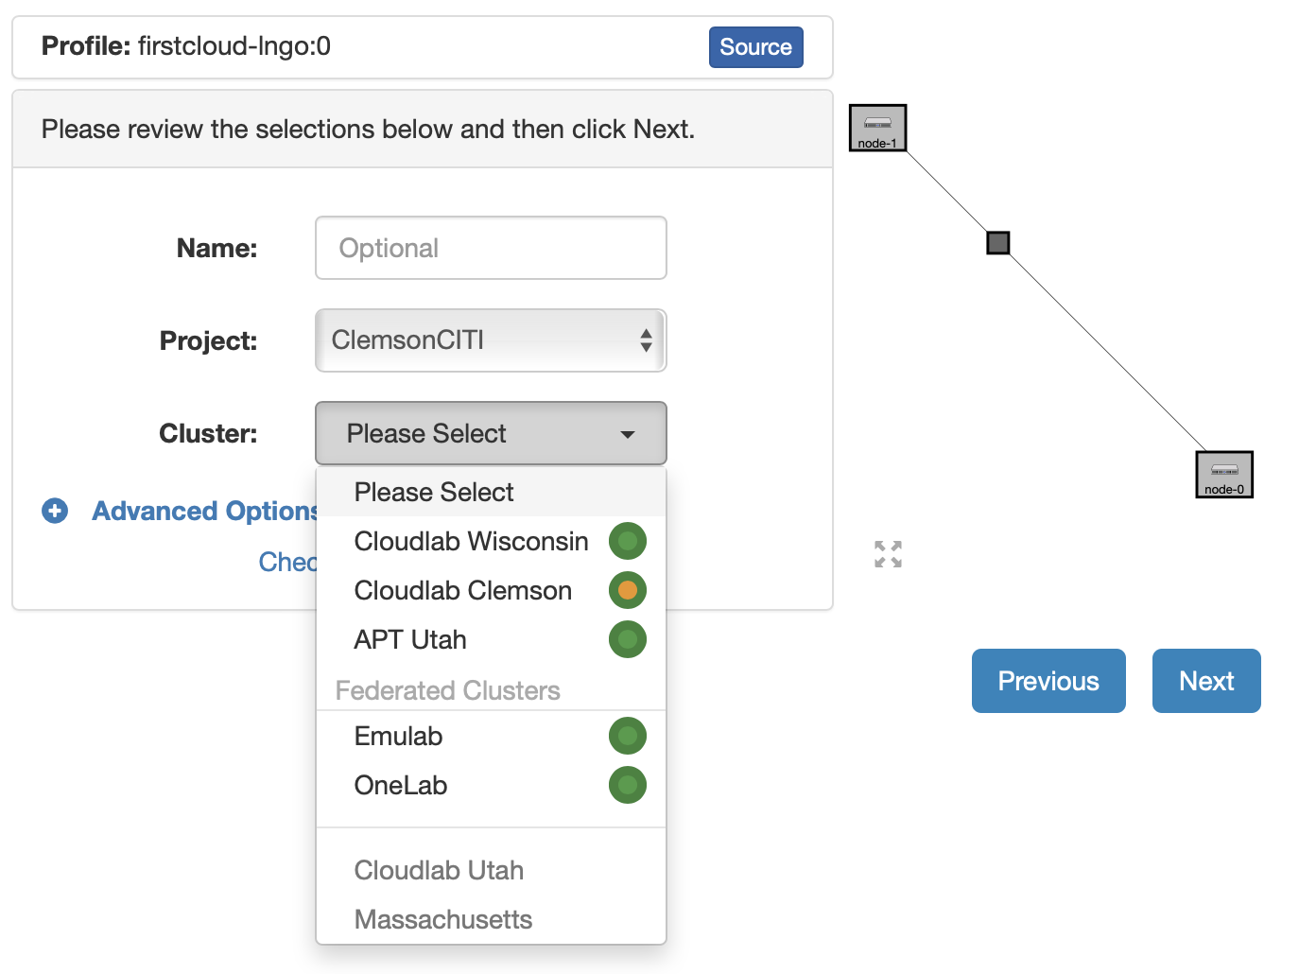
You can select where you want to deploy this particular cluster. Click next when done

Slide 31
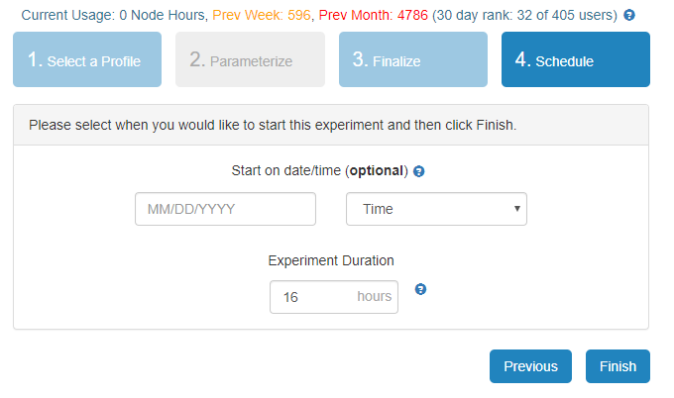
Finish …

Slide 32
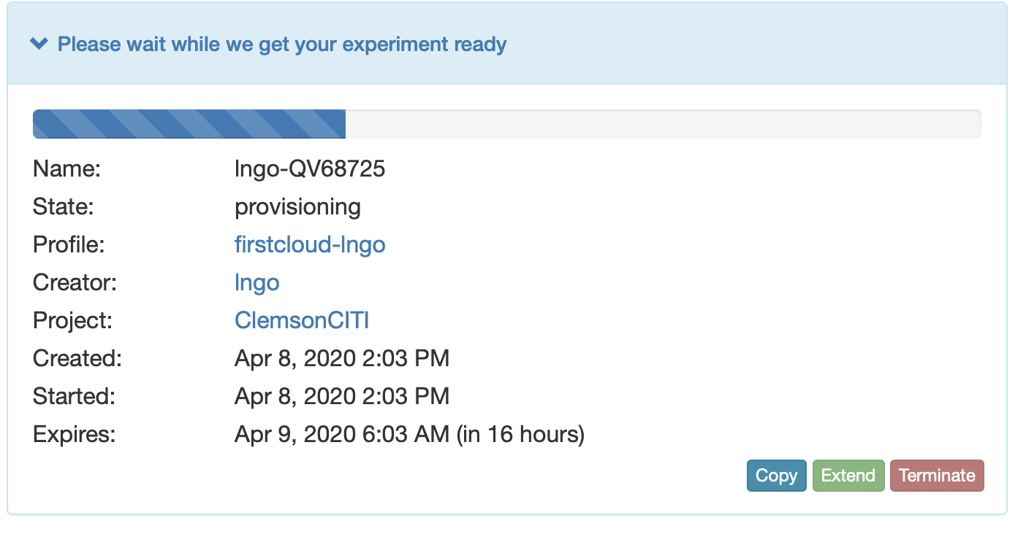
Created and Provisioning

Slide 33
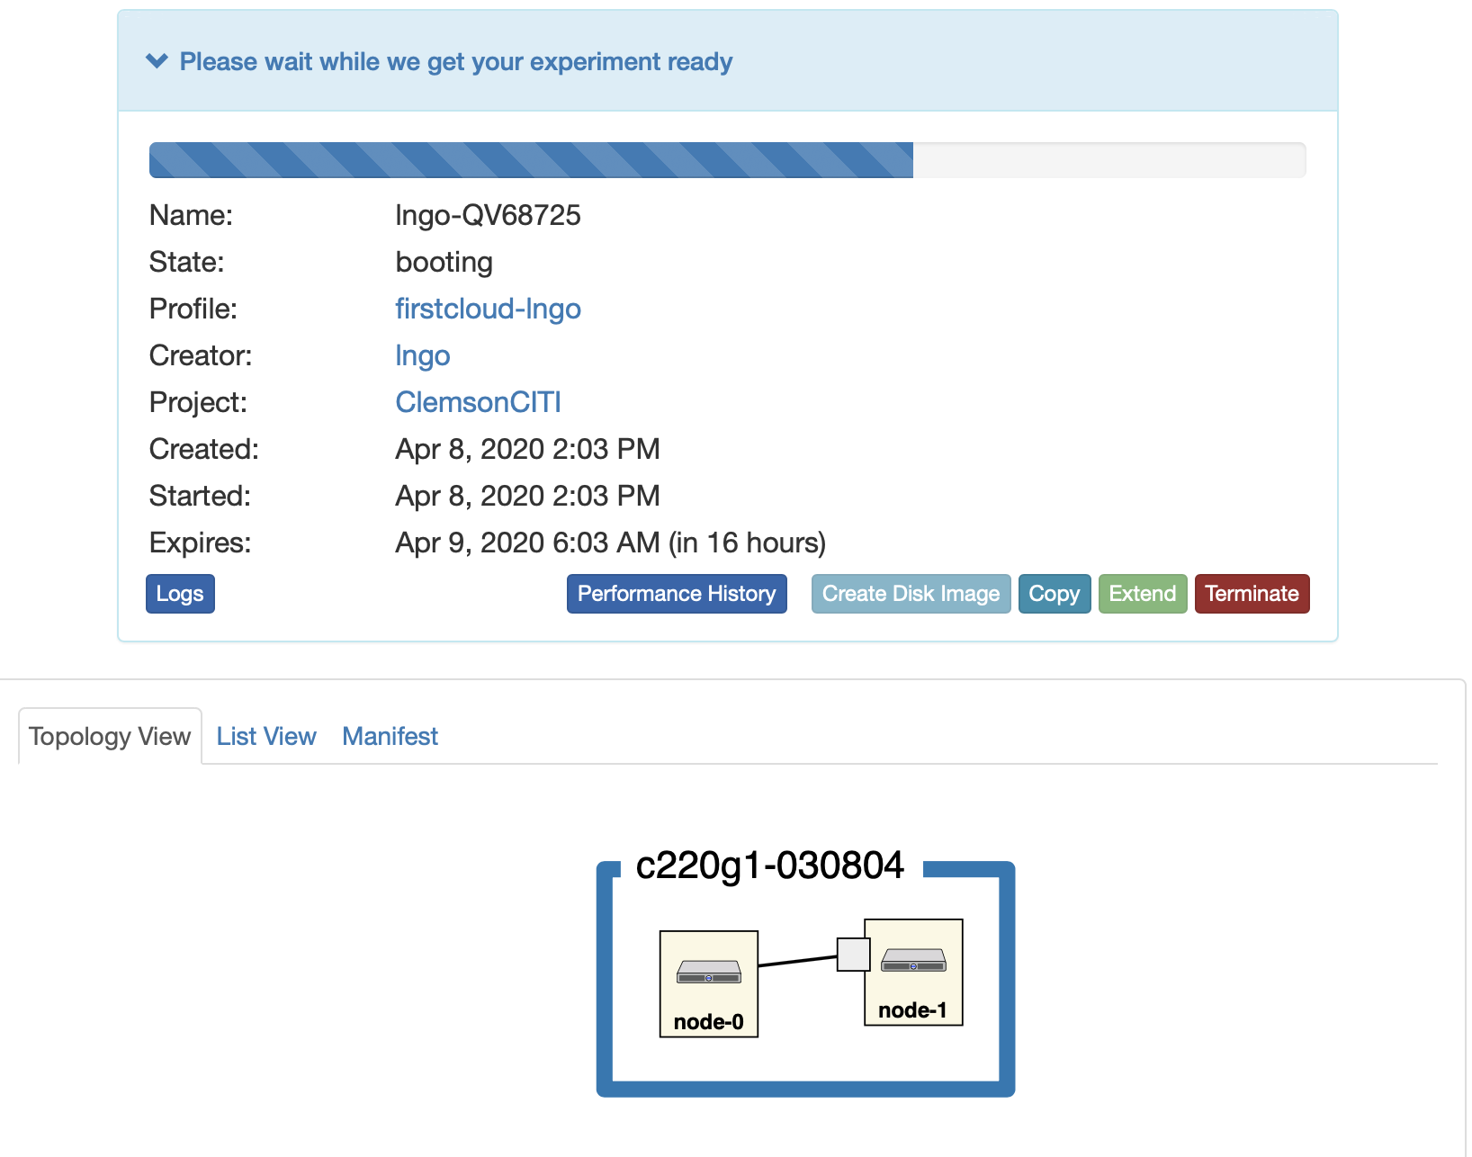
Booting

Slide 34
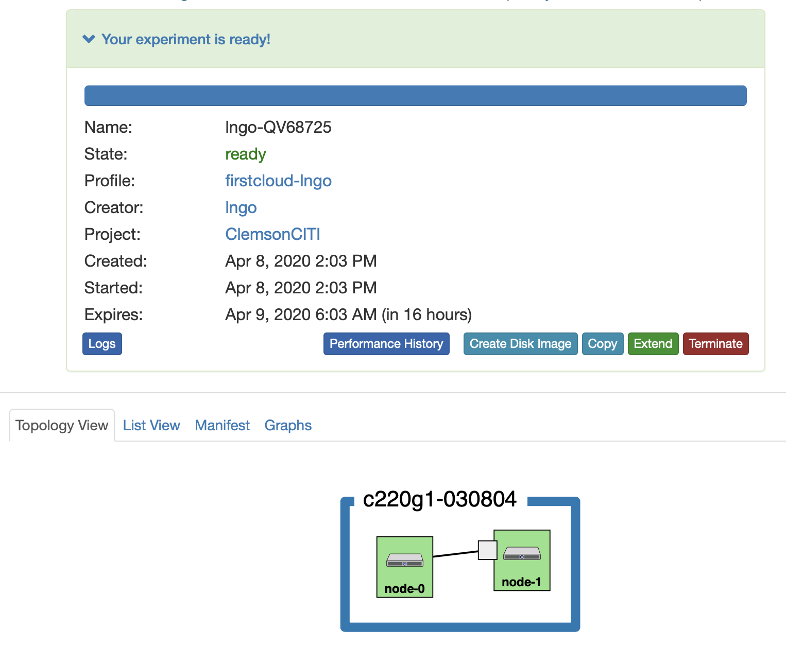
Ready to go

Slide 35
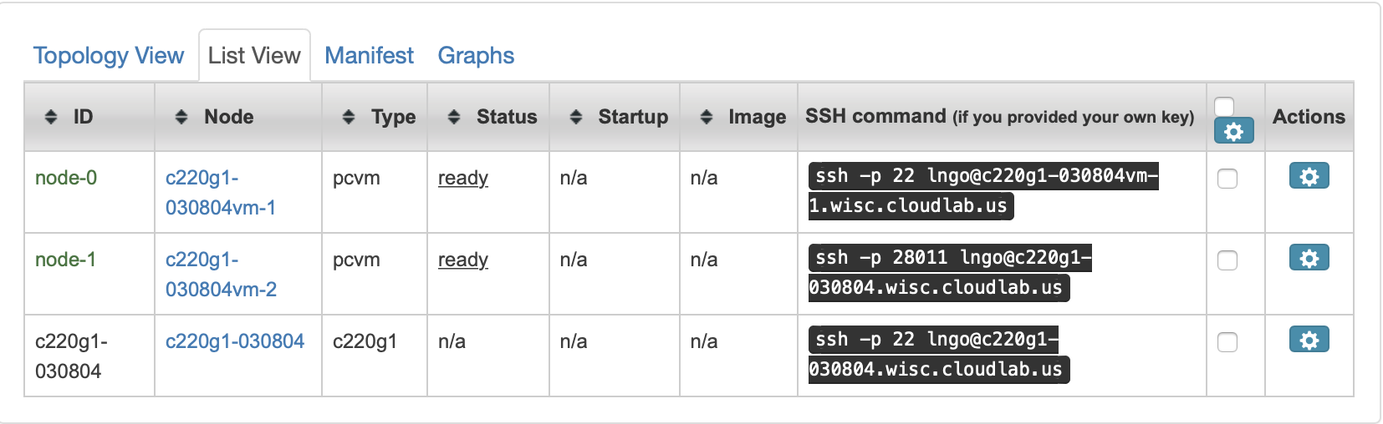
What do we have
Two VM nodes inside one physical node
node-0 (VM) has a public IP (hence SSH port 22 and hostname is different from physical node).
node-1 (VM) does not have a public IP, so SSH go through an alternative port from the physical node.

Slide 36
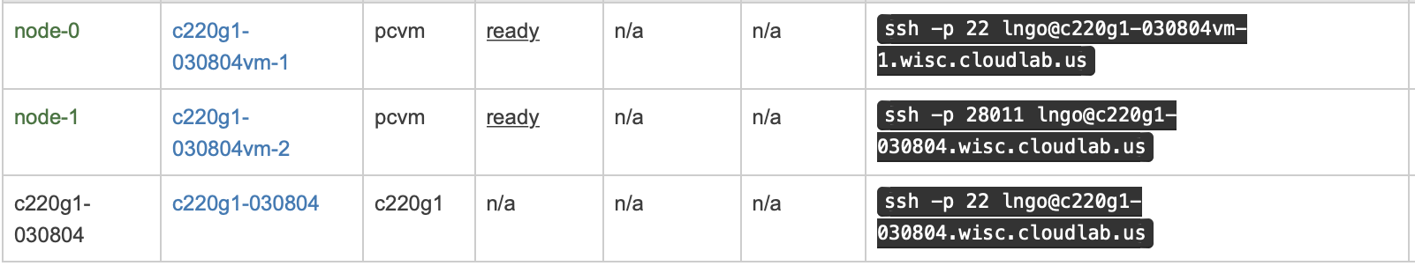
How to access (if you have SSH key setup properly)

Slide 37
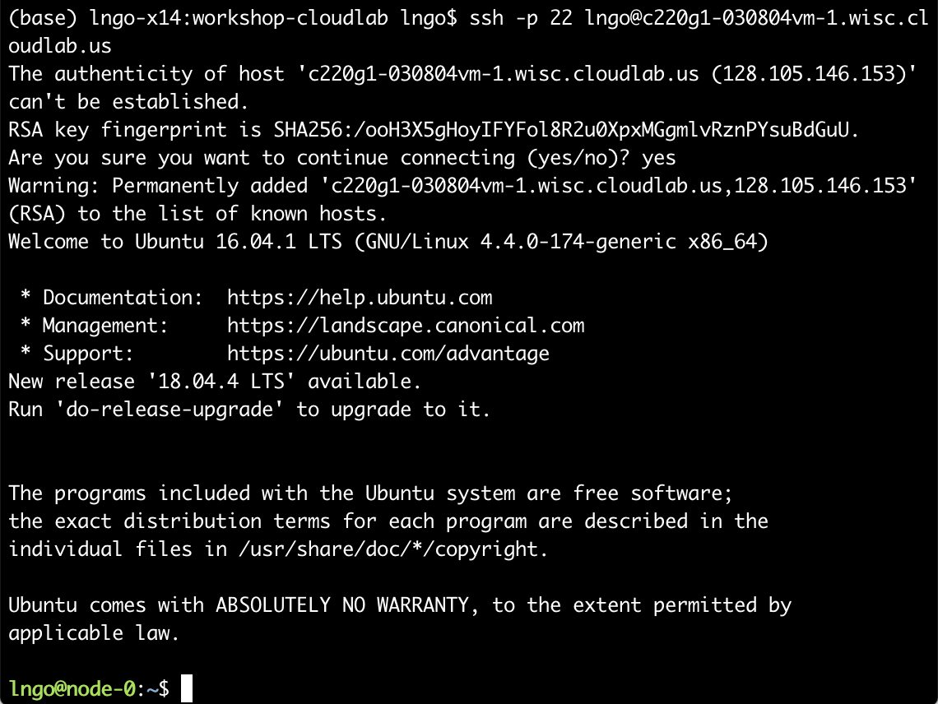

Slide 38
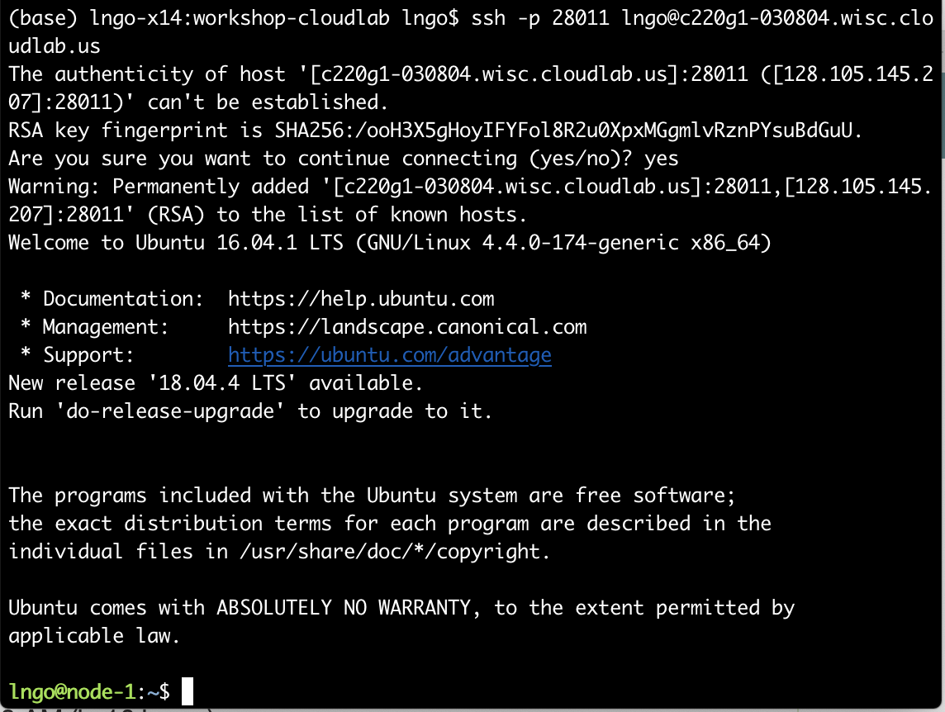

Slide 39
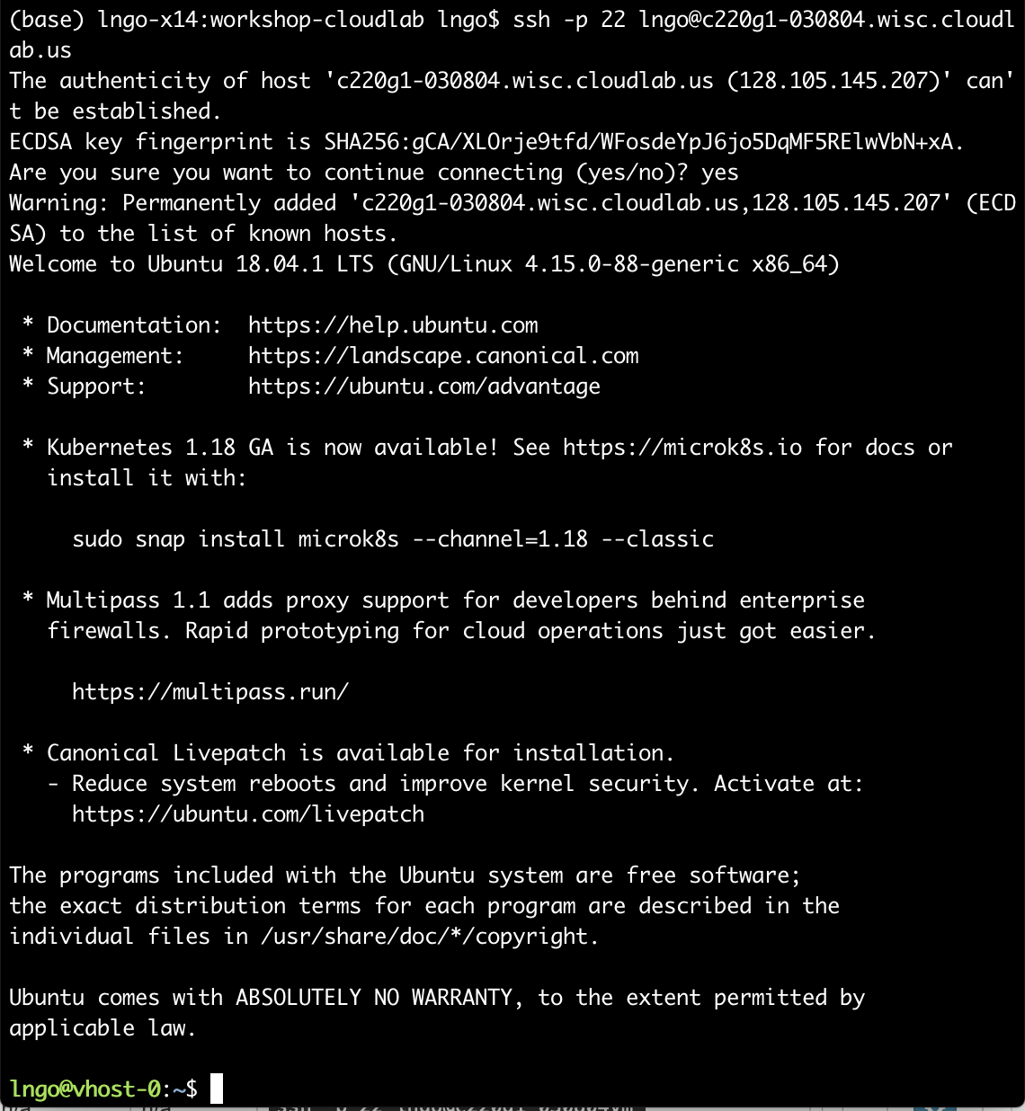

Slide 40
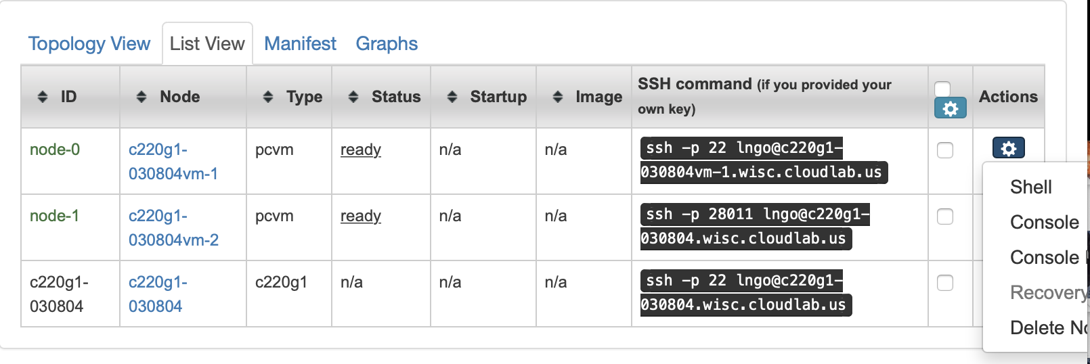
How to access? Via external ssh in the long term. Browser

Slide 41
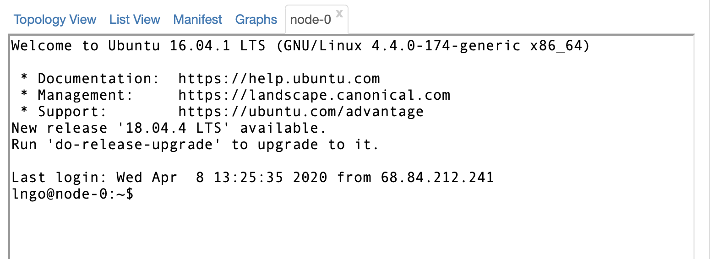
Shell give you user’s terminal access

Slide 42
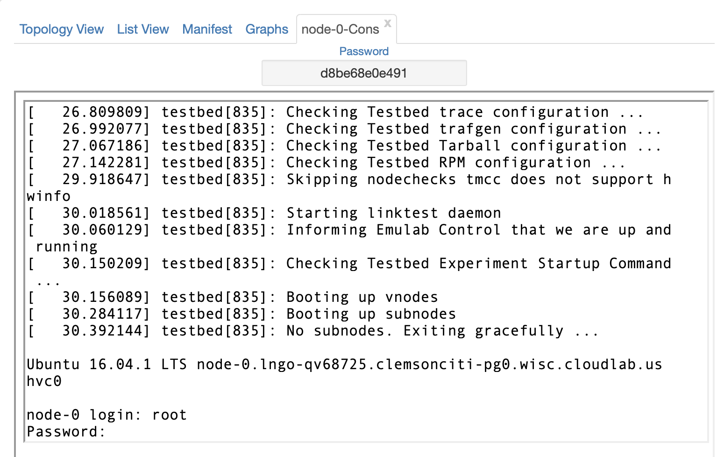
Console give you root and password

Slide 43
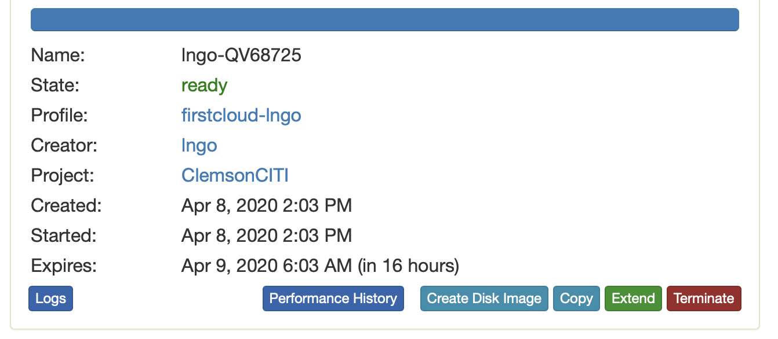
Extend to request extension, Terminate to kill your experiment

Slide 44
Important
CloudLab is for experimental work, not production work

Slide 45
CloudLab
CloudLab profile via GitHub and Python

Slide 46
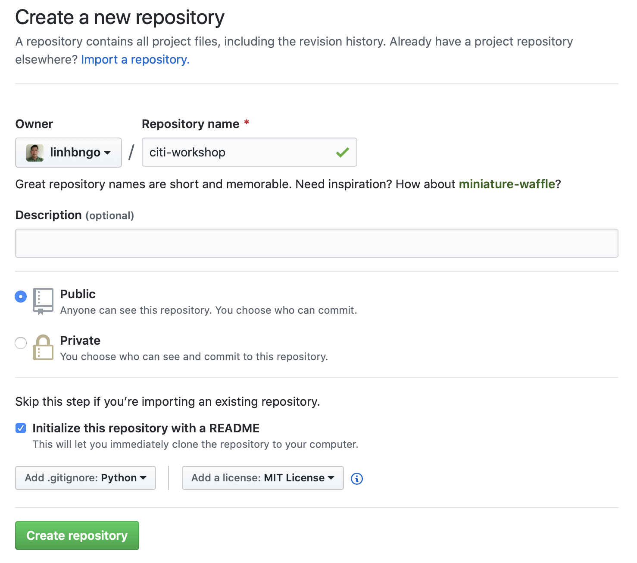
GitHub
Log in to your GitHub account (or create one if you don’t already have one!)
Create a new repository titled citi-workshop, with options as shown in the screenshot.

Slide 47
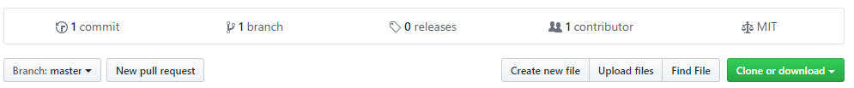
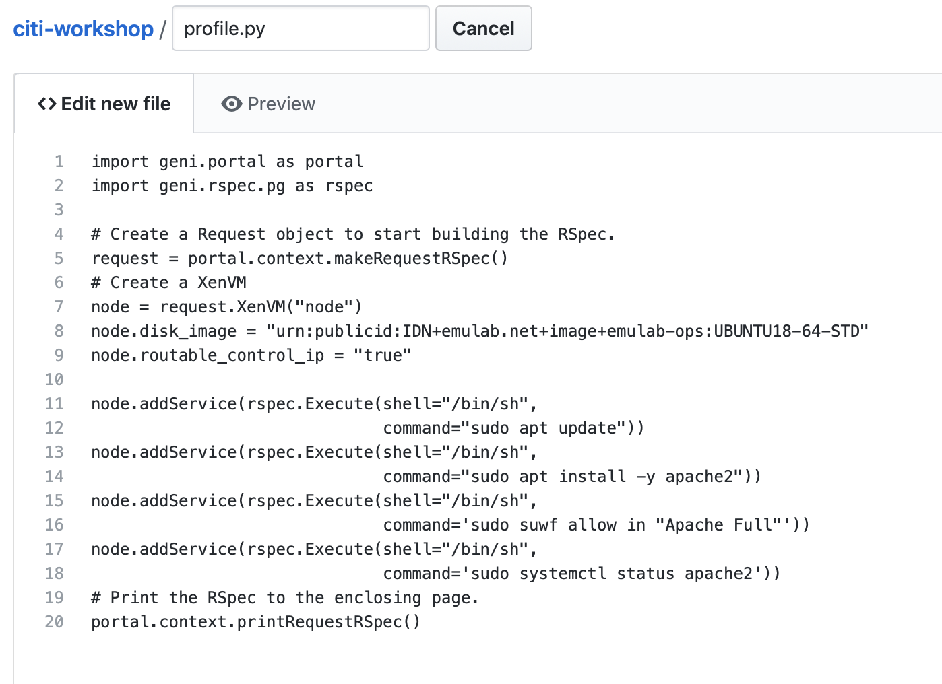
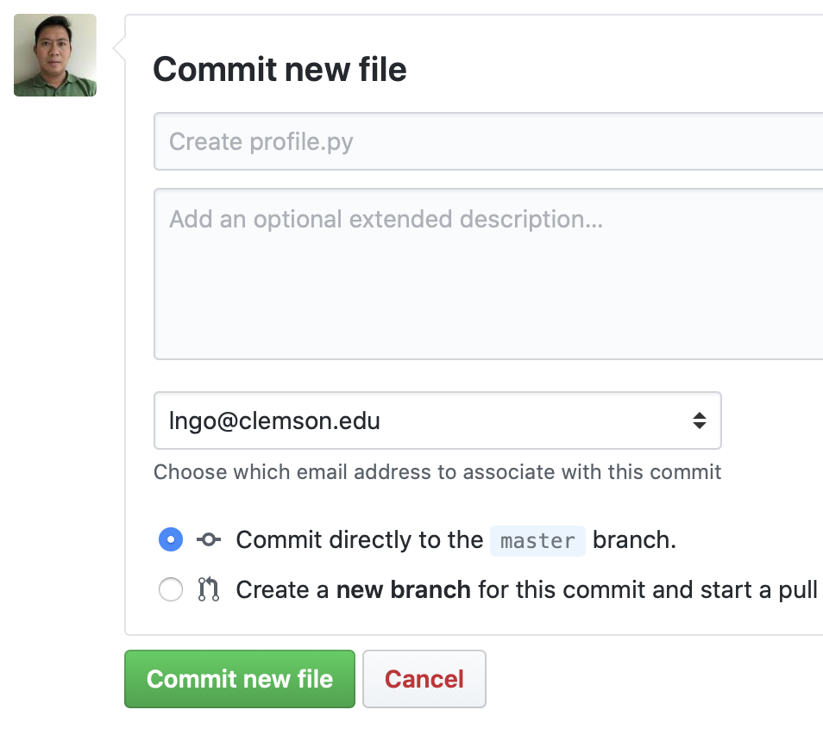
GitHub
Click Create new file to add a new file to your repository.
Name the file profile.py
Add the contents from https://github.com/linhbngo/citi-workshop/blob/master/profile.py to this file.
Click Commit new file at bottom of page to save the file.

Slide 48
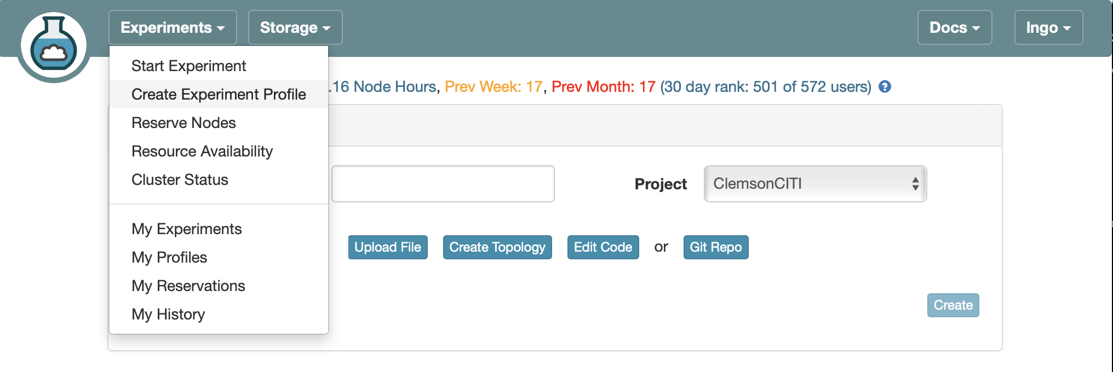
Create a new CloudLab profile using Git Repo

Slide 49
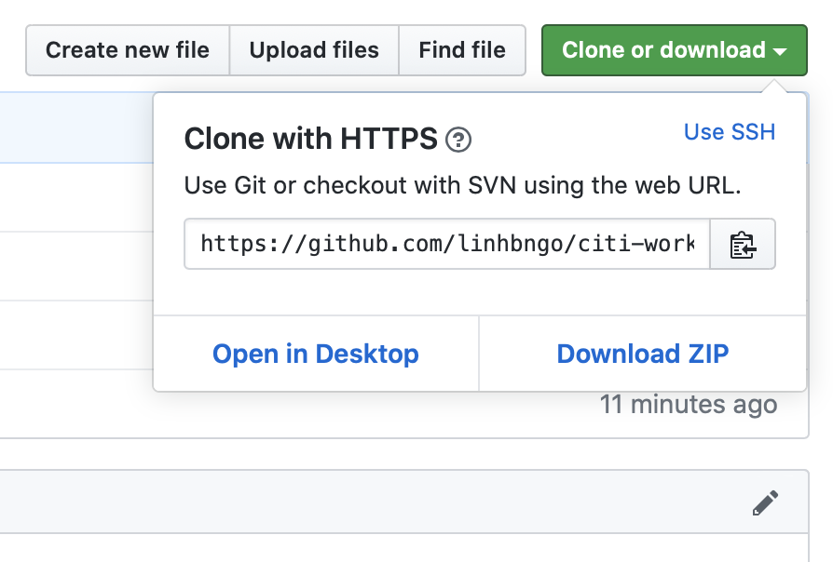
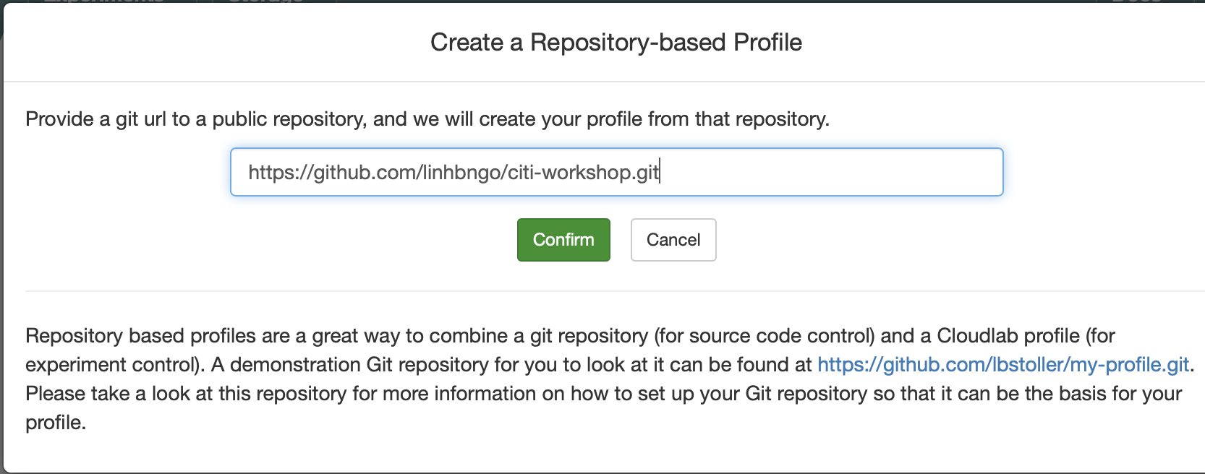
Copy the URL of your repository into the box

Slide 50
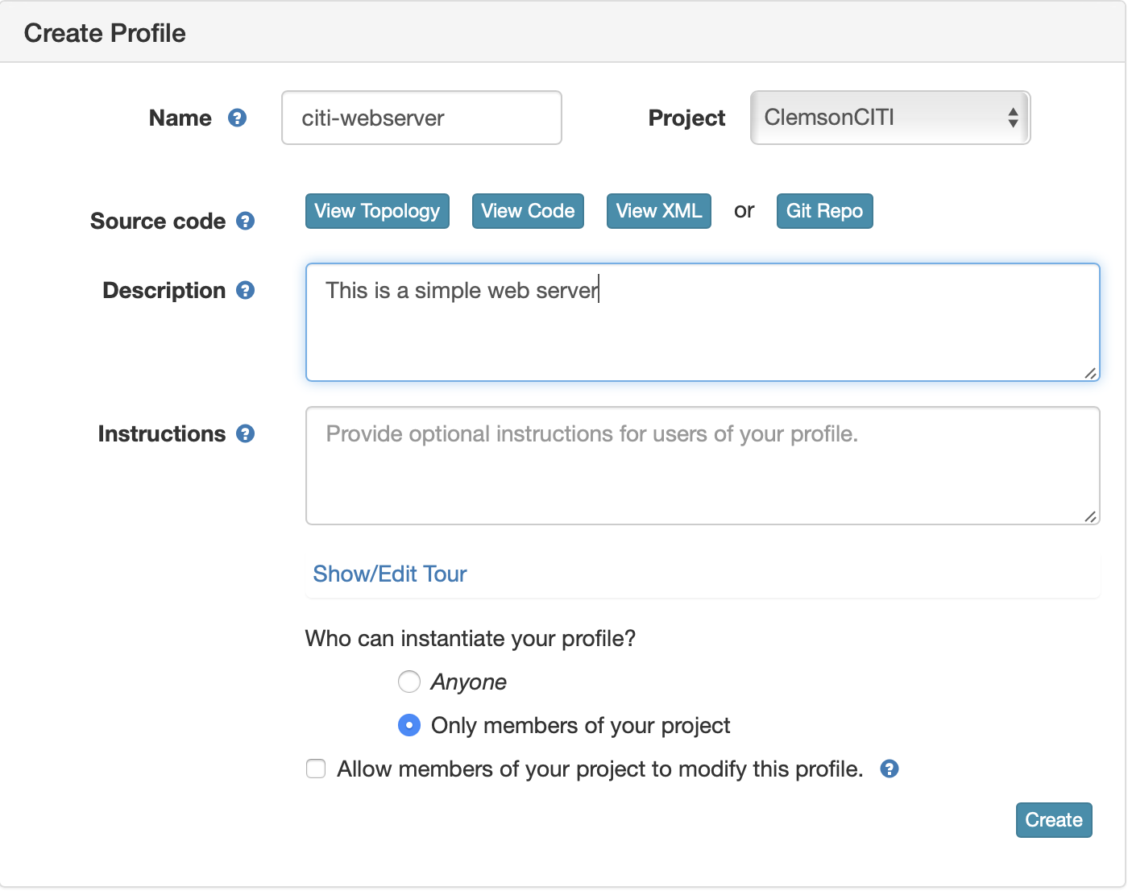
Create the profile (with your username)

Slide 51
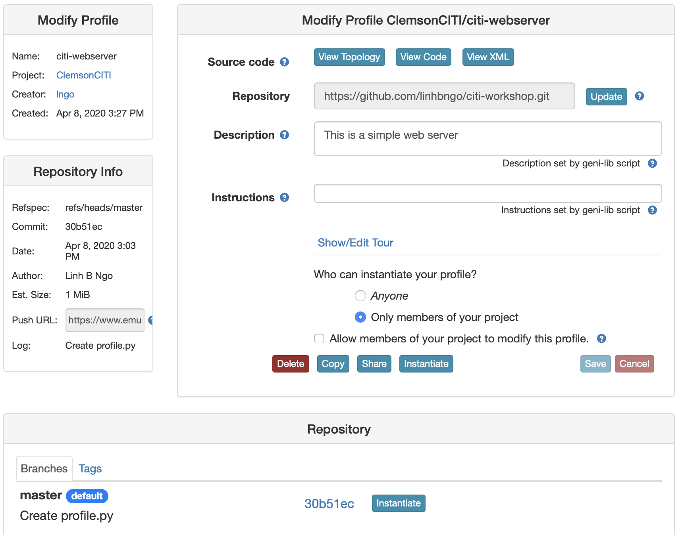

Slide 52
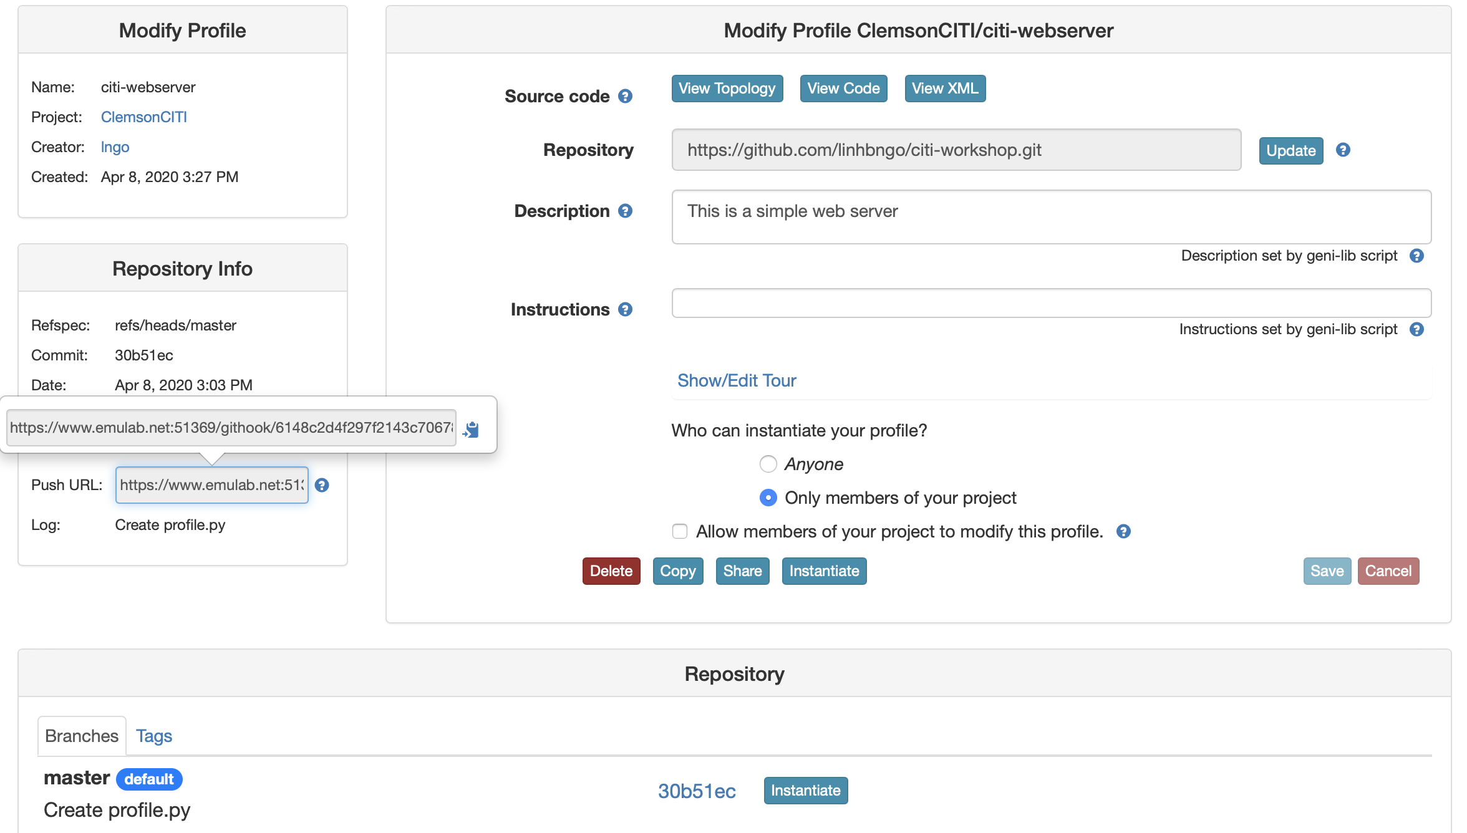
Setup webhook
Update GitHub will automatically update CloudLab profile

Slide 53
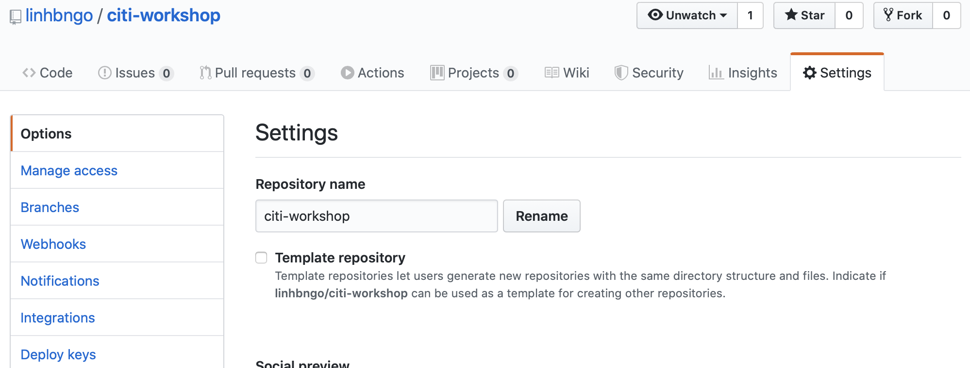

Slide 54
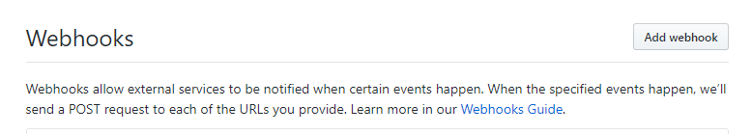

Slide 55
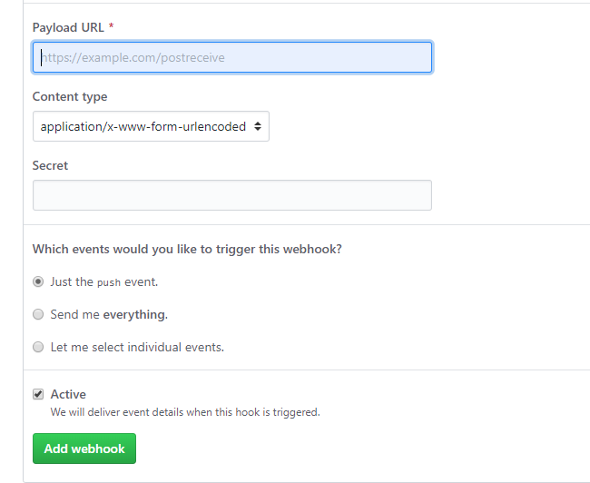
Paste the URL emulab.net .. URL copied from slide here, then click Add webhook

Slide 56
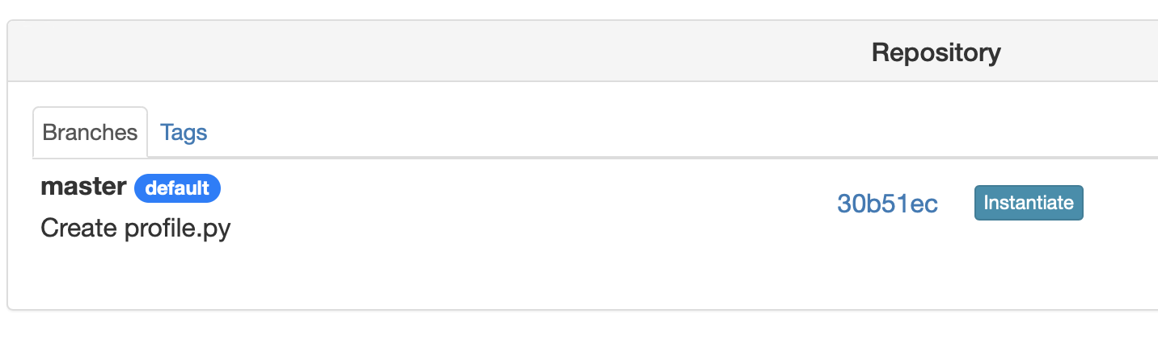
Instantiate the profile on the master branch

Slide 57
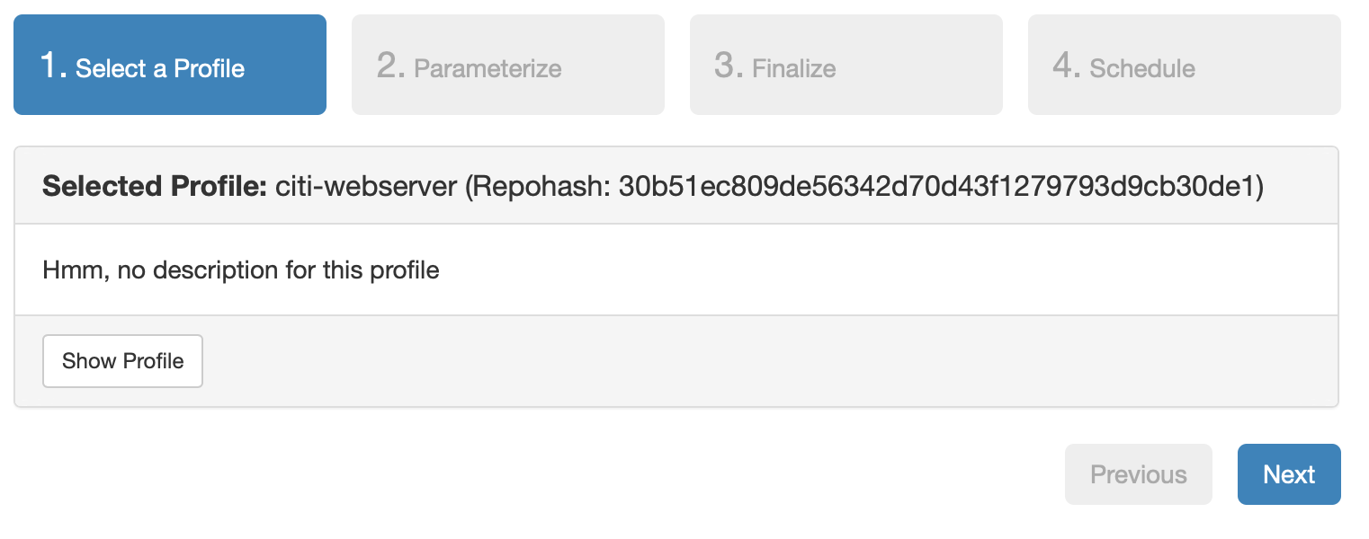
Pay attention to the repo hash (matched with GitHub)

Slide 58
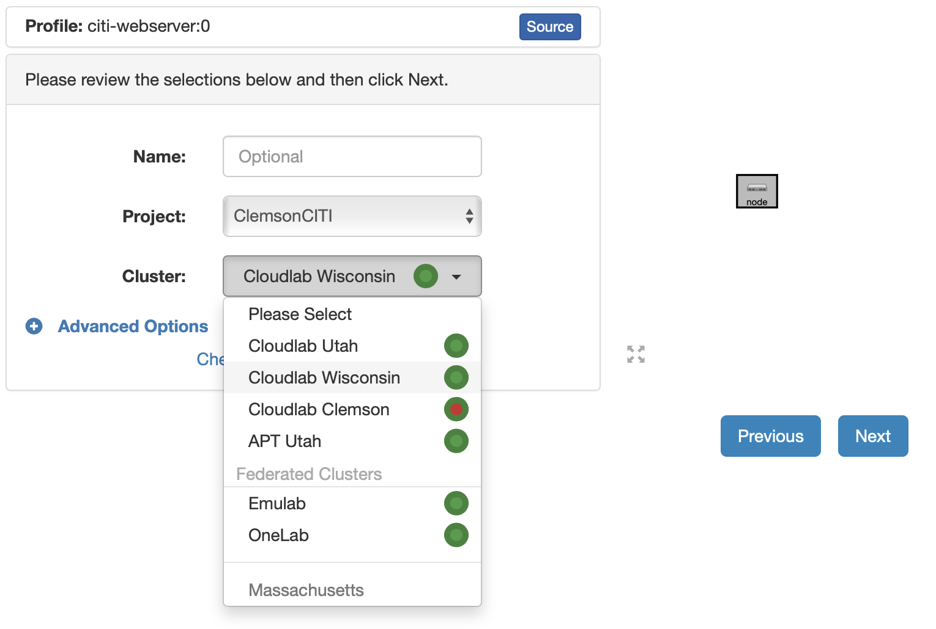
Select a site

Slide 59
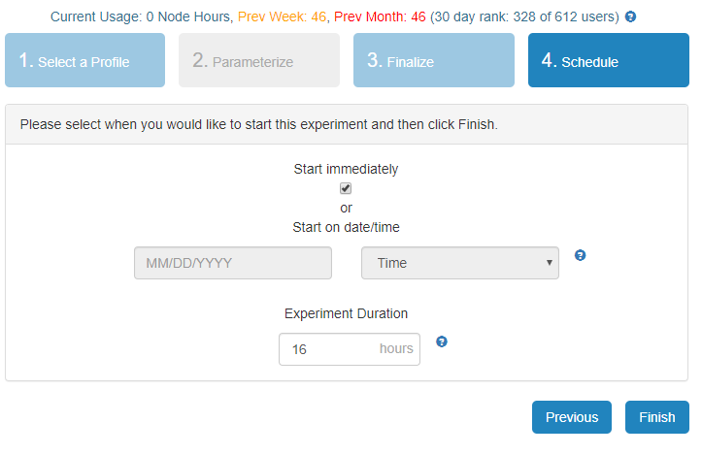
How long do we initially have?

Slide 60
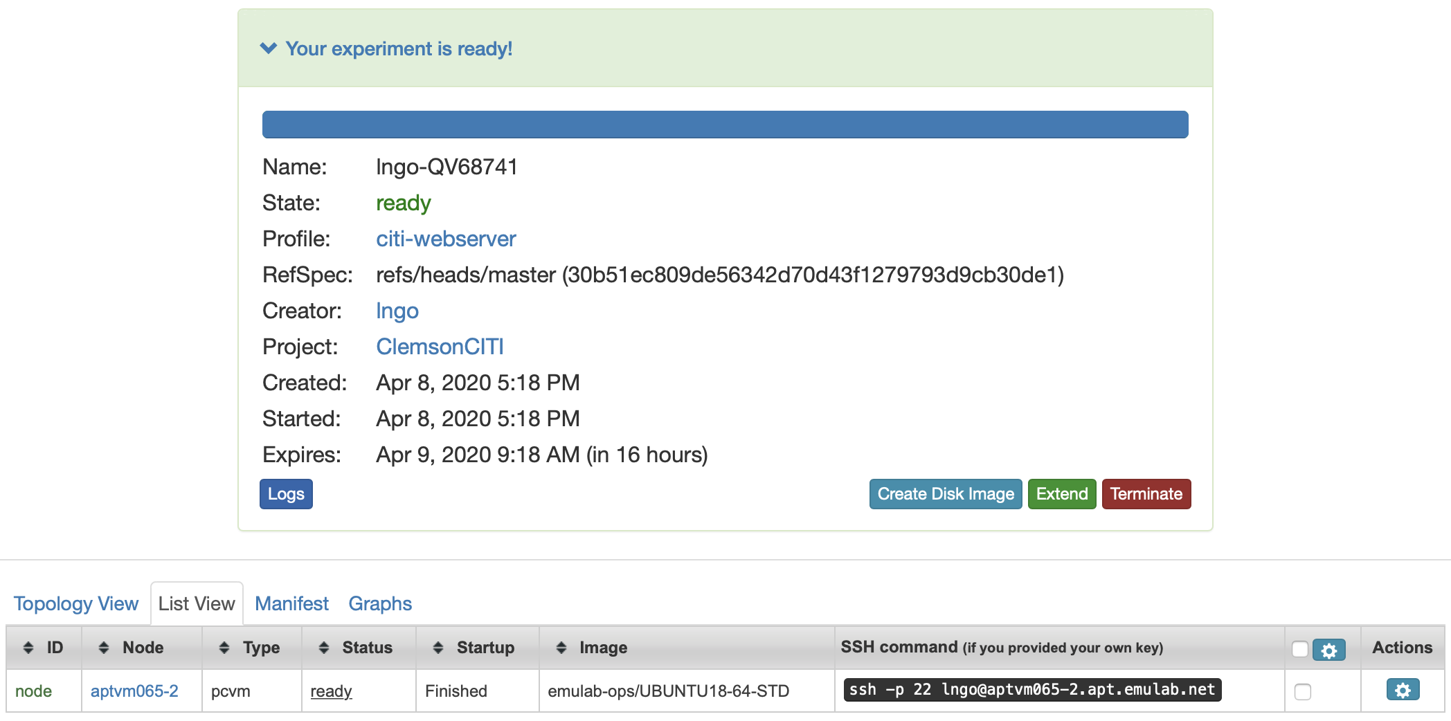

Slide 61
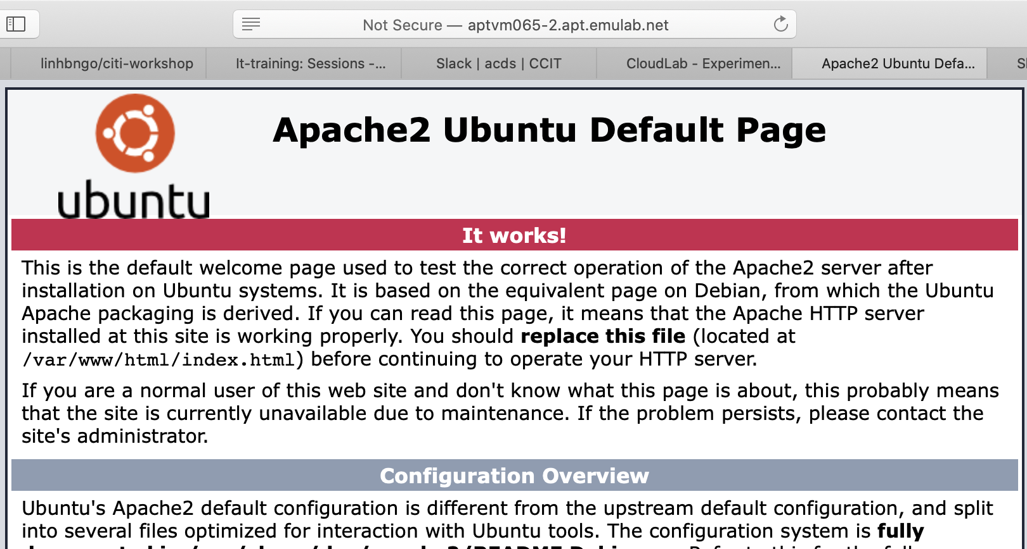

Slide 62
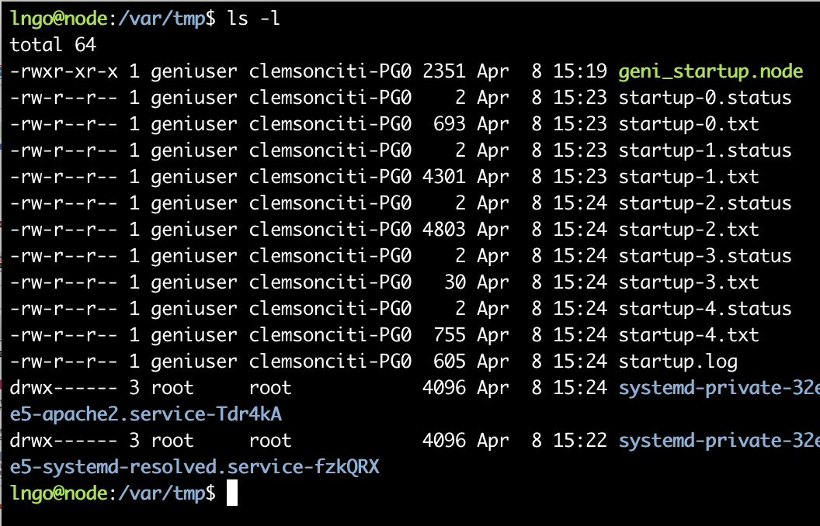
What is CloudLab doing?
Logs of custom script execution are stored under /var/tmp
startup-0 is basically the cloning of the git repository
startup-*.txt (from 1 onward) log execution process of all statements done by pg.Execute
startup-*.status briefly provide a final status of execution. 0 means success, 1 means failure.

Slide 63

Repository location
GitHub content is stored at /local/repository

